Slide 1

SIDDAGANGA INSTITUTE OF TECHNOLOGY TUMAKURU-572103
(An Autonomous Institute affiliated to VTU)
DEPARTMENT OF INFORMATION SCIENCE AND ENGINEERING
2017-18
“MERKLE TREE”
BY: PAWAN KUMAR GANJHU
1SI14IS029

Slide 2
AGENDA
INTRODUCTION
WHO USES MERKLE TREE
WHY MERKLE TREE
PROPERTIES
MERKLE HASH TREE
AUTHENTICATE DATA STRUCTURE
MERKLE TREE OPERATION
APPLICATION
ADVANTAGES & DISADVANTAGES
CONCLUSION
BIBLIOGRAPHY

Slide 3
INTRODUCTION
Introduced by Ralph Merkle, 1979
“Classic” cryptographic construction
Involves combining hash functions on binary tree structure
A Merkle tree is typically a binary tree in which each leaf represents the hashed value of the record associated with that leaf.
The branches are the hash of the concatenated hashes of the two children. This process of re-hashing the concatenation of the child nodes to create the parent node is performed until the top of the tree is reached, called the "root hash."

Slide 4

Who Uses Merkel Trees?
In Digital Currency, it is used for
consistency verification
data verification
data synchronization
Global Supply Chain
Health Care Industry
Capital Markets

Slide 5
Why Merkle Trees?
Significantly reduces the amount of data that a trusted authority has to maintain to proof the integrity of the data.
Significantly reduces the network I/O packet size to perform consistency and data verification as well as data synchronization.
Merkel trees provide a means of proving that integrity / validity of your data.
Merkel trees require little memory / disk space and proofs are computationally easy and fast.

Slide 6
Properties
Fast
Authentic
Deterministic
Proof of Existence
Proof of non-existence

Slide 7
Merkle Hash Trees
Authenticate a sequence of data values D₀ , D₁ , …, D_{N}
Construct binary tree over data values
T₀
T₁
T₂
T₃
T₄
T₅
T₆
D₀
D₁
D₂
D₃
D₄
D₅
D₆
D₇

Slide 8
Merkle Hash Trees II
Verifier knows T₀
How can verifier authenticate leaf D_{i} ?
Solution: re-compute T₀ using D_{i}
Example authenticate D₂ , send D₃ T₃ T₂
Verify T₀ = H( H( T₃ || H( D₂ || D₃ )) || T₂ )
T₀
T₁
T₂
T₃
T₄
T₅
T₆
D₀
D₁
D₂
D₃
D₄
D₅
D₆
D₇

Slide 9
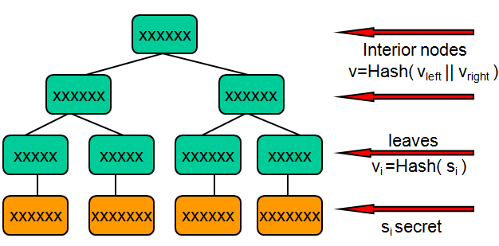
Authenticated Data Structure with Merkle Hash Tree
An Authenticated Data Structure enables an untrusted party to answer queries on behalf of data owner
Each query answer comes with a proof of correctness
Useful in data outsourcing, database as a service, cloud computing, etc.
A merkle hash tree enables proof of size O(log n)

Slide 10
Merkle tree, signing
v_{e}
Signature = <v_{e}, Sig₀(v_{e})>
v_{i} = hash ( x_{i} + v_{i0} + v_{i1} )
v₀
v₁
Construct
Verify
v₀₀
v₀₁
v₁₀
v₁₁
v₀₀₀
v₀₀₁
v₀₁₀
v₀₁₁
v₁₀₀
v₁₀₁
v₁₁₀
v₁₁₁
X=
x₀₀₀
x₀₀₁
x₀₁₀
x₀₁₁
x₁₀₀
x₁₀₁
x₁₁₀
X₁₁₁

Slide 11
Merkle tree, deletion
v_{e}
Signature = <v_{e}, Sig₀(v_{e})>
v_{i} = hash ( x_{i} + v_{i0} + v_{i1} )
v₀
v₁
Verify
Construct
v₀₀
v₀₁
v₁₀
v₁₁
v₀₀₀
v₀₀₁
v₀₁₀
v₀₁₁
v₁₀₀
v₁₀₁
v₁₁₀
v₁₁₁
X =
x₀₀₀
x₀₀₁
x₀₁₀
x₀₁₁
x₁₀₀
x₁₀₁
x₁₁₀
X₁₁₁

Slide 12
Application
Digital Currency
Global Supply Chain
Health Care Industry
Capital Markets
Git and Mercurial

Slide 13
ADVANTAGES DISADVANTAGES
consistency verification
data verification
data synchronization
it is stateful
we must know in advance the number of messages to be signed
the length of the secret key is too long

Slide 14
CONCLUSION
Merkle scheme is existentially un-forgeable under adaptive chosen message attack.
On the edges, however, cheaper and more varied Merkle computing could open a much wider, more open, audit-able, shared & verifiable computing substrate.
Exploring more generic and varied Merkle computing with different styles of computational courts could lead to some very interesting, emergent applications.

Slide 15
BIBLIOGRAPHY
Modern Algorithm and Data Structures Part I, Bloom Filters, Merkle Tree, Lorenzo Abberton 18th April 2011
Darmstadt University of Technology, Department of Computer Science, Cryptography and Computer Algebra, Merkle Tree Traversal Techniques, Bachelor Thesis by, Boris Ederov, Prof. Dr. Johannes Buchmann Supervised by Erik Dahmen, April 2007
https://github.com/IAIK/merkle-tree
https://en.wikipedia.org/wiki/Merkle_tree
https://www.quora.com/What-is-a-merkle-hash-tree

Slide 16

Thank You…

